Slide 1
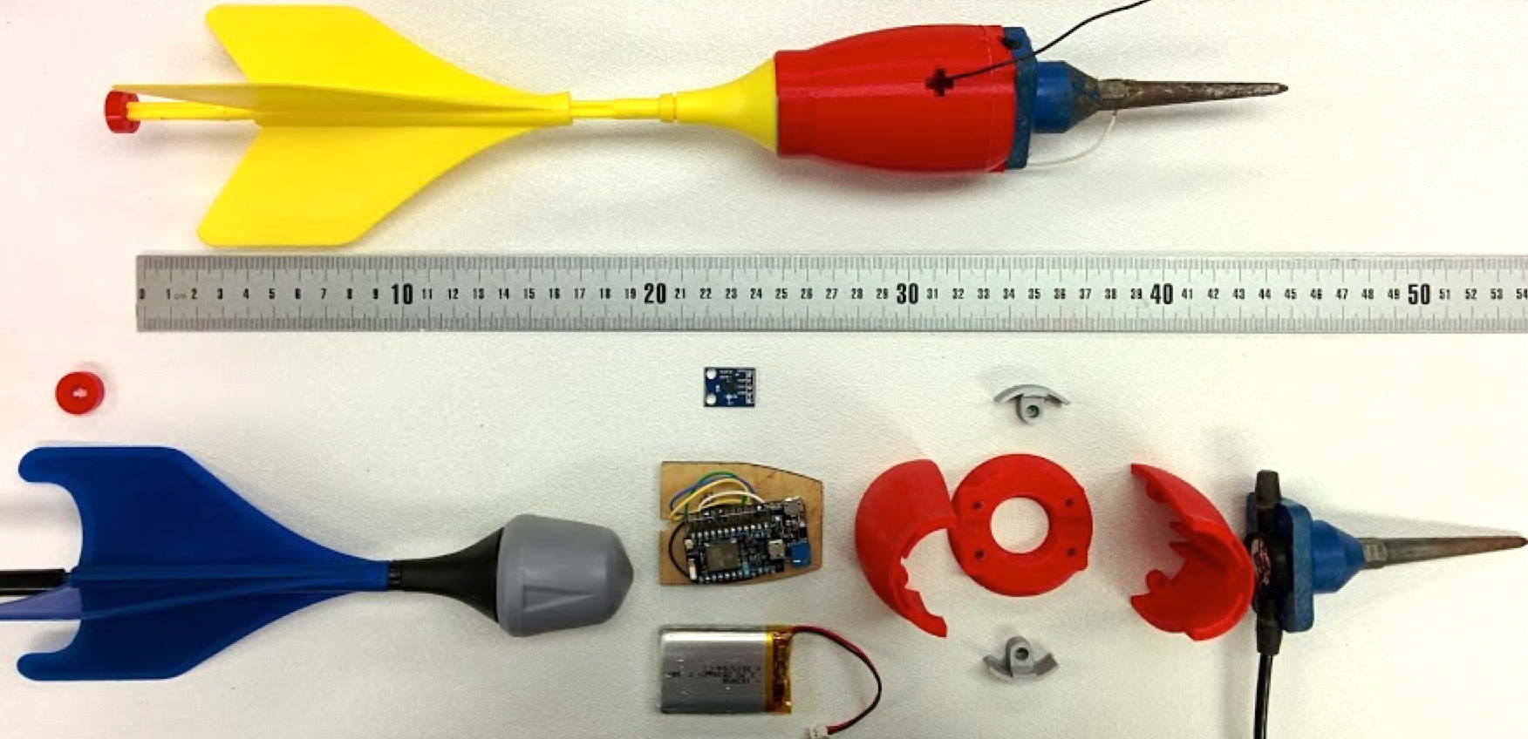
Attachment for deployment mechanism
3D printed outer case
Accelerometer
Geophone
(Sensors)
Micro-controller
Battery
Lawn JartTM

